Slide 1
Advanced Object-Oriented Analysis & Design
Dr. M.E. Fayad, Professor
Computer Engineering Department, Room #283I
College of Engineering
San José State University
One Washington Square
San José, CA 95192-0180
http://www.engr.sjsu.edu/~fayad
2003
SJSU -- CmpE

Slide 2
Lesson 8:
CRC Cards
2
2003
SJSU – CmpE --- M.E. Fayad

Slide 3

Lesson Objectives
  Understand the existing CRC Cards
  Understand the problems with existing CRC Cards
  Understand and use my CRC Cards
  Learn how to create a CRC Cards
3
2003
SJSU – CmpE --- M.E. Fayad

Slide 4
Existing CRC Cards (1)
CRC stands for Class, Responsibilities, Collaborations
Basic Ideas
  Create a card for each class
  Assign responsibilities and attributes to each card
  Identify collaborations between cards
  Simulate design scenarios between sets of cards
4
2003
SJSU – CmpE --- M.E. Fayad

Slide 5
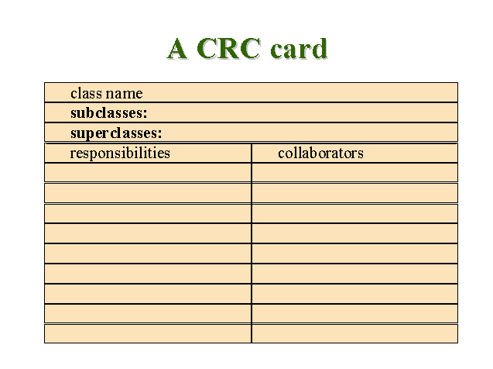
Existing CRC Cards (2)
5
2003
SJSU – CmpE --- M.E. Fayad

Slide 6
Major Problems with Existing CRC Cards
Macho Class
Duplicate Functionality
Difficulty in Defining Responsibilities
No Clear Role is Defined
Hard to Map CRC Cards to Class Diagram
6
2003
SJSU – CmpE --- M.E. Fayad

Slide 7
Proposed CRC Cards (1)
Class (Role)
Responsibility
Collaboration
Client
Server
7
2003
SJSU – CmpE --- M.E. Fayad

Slide 8
CRC Cards (2)
General
  Each class is described on a separate 3X5 or 4X6 card
The cards are known as CRC cards; they have 3 sections:
  Class
  Responsibilities
  Collaborations
8
2003
SJSU – CmpE --- M.E. Fayad

Slide 9
CRC Cards (2)
Class Name X (Role)
Responsibility
Collaboration
Client Server
1. Specify One
2. Unique Responsibility
3. Within context
Collaborators
Services or Interfaces that are provided by the named X class
9
2003
SJSU – CmpE --- M.E. Fayad

Slide 10
CRC Cards (3)
Role name
ATM (Automatic Teller)
Responsibility
Collaboration
Client Server
Access & modify
account balance Account Balance Inquiry
        Deposit Transaction
        Funds Transfer
        Withdrawal Transaction
10
Collaborator
2003
SJSU – CmpE --- M.E. Fayad

Slide 11
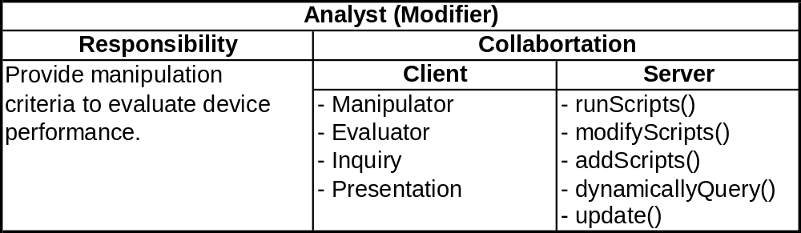
CRC Cards (4)
Prepare a CRC card for each identified class
  Define class role
  Provide one unique responsibility
  Identify collaborators (Clients and Services)
11
2003
SJSU – CmpE --- M.E. Fayad

Slide 12
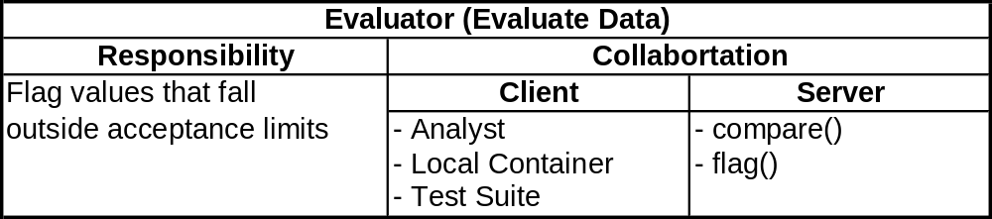
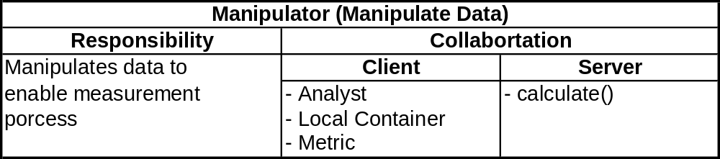
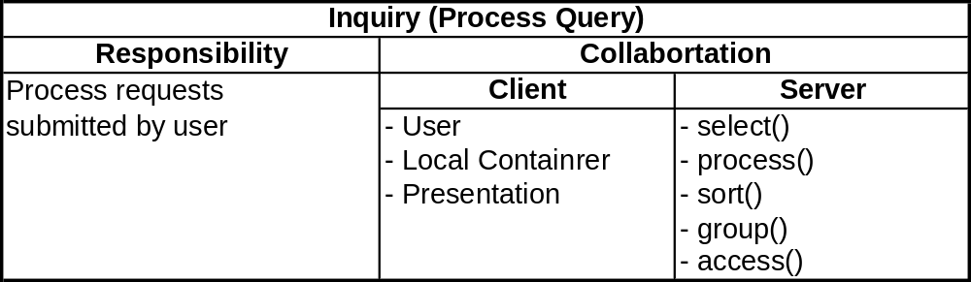
CRC Cards (5)
12
2003
SJSU – CmpE --- M.E. Fayad

Slide 13

Discussion Questions
What are the good, bad, and ugly about CRC cards?
Propose a process of how to use the CRC cards
T/F
  CRC stands for Common Responsible Class
  CRC cards contains many responsibilities per class.
  In the CRC cards, collaborators don’t have any relationship with the CRC’s named class.
Define:
  CRC, responsibilities, and collaborators
13
2003
SJSU – CmpE --- M.E. Fayad

Slide 14
Questions for the Next Lecture
Discuss how to identify objects, classes, attributes, operations, and relationships
14
2003
SJSU – CmpE --- M.E. Fayad

